Slide 1
Course code:- E1UA307C Course Name:- JAVA ONLINE E-COMMERCE PLATFORM
1.Raviranajan kumar
(23scse1012123)
2.Himanshu Tiwary
(23scse1011208)
3.Gaurav kumar
(23scse1012062)
4.Anmol kumar
(23scse1011098)
ARPESH SINGH
GALGOTIAS UNIVERSITY

Slide 2
OBJECTIVE
Facilitating Online Transactions: The primary objective is to enable seamless buying and selling of products or services through the internet, offering customers an easy way to shop online.
Expanding Market Reach: An e-commerce platform allows businesses to reach a wider audience, breaking geographical barriers and offering goods to a global market.
Enhancing Customer Experience: Providing customers with a user-friendly interface, convenient payment options, secure transactions, and efficient customer service.
Reducing Operational Costs: E-commerce platforms help reduce the overhead costs associated with physical stores, such as rent, utilities, and in-store staff.
Inventory and Order Management: The platform aims to streamline processes like inventory management, order tracking, and customer relationship management, improving overall operational efficiency.
Data Collection and Analytics: Collecting user data to analyze shopping patterns, improve marketing strategies, and make informed business decisions.
Building Brand Presence: An e-commerce platform can help build and maintain an online presence, enhancing brand awareness and loyalty.

Slide 3


Slide 4
Problem Statement: Develop an online e-commerce platform that allows users to search for products, view details, add products to a shopping cart, and proceed to checkout for purchase. The platform should manage product inventory, handle user authentication, and support various payment methods.
1. User Authentication:
Users must be able to register and log in to the platform.
Provide secure password storage (e.g., through encryption).
Support user roles like admin and customer.
2. Product Catalog: Display a list of products with details like name, price, description, and image. Allow product search and filtering by categories or price range. Admins can add, update, or remove products from the inventory. 3. Product Catalog: Display a list of products with details like name, price, description, and image. Allow product search and filtering by categories or price range. Admins can add, update, or remove products from the inventory.

Slide 5
4.Checkout and Payment:
Allow users to proceed to checkout after reviewing their cart.
Support payment methods such as credit card, PayPal, etc.
Handle billing and shipping information.
Order Management:
Track the status of user orders (e.g., pending, shipped, delivered).
Admins can view, update, and manage orders.
6. Inventory Management:
.Admins should be able to manage stock levels.
The system should automatically update stock levels after purchases.
7. Optional Features:
Product reviews and ratings.
Discount coupons or promotional offers.
Wishlist functionality.
Email notifications for order confirmation.

Slide 6
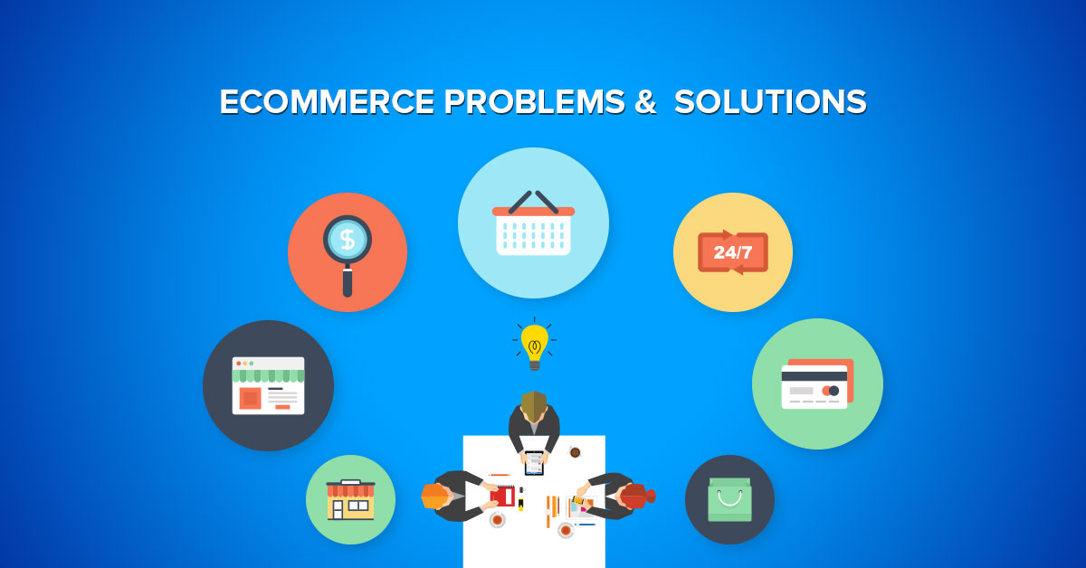
Non-Functional Requirements:
Scalability: The platform should be able to handle a large number of products and users.
Security: Ensure secure transactions and data protection, especially for user and payment information.
Performance: Fast load times and efficient search and filtering of products.
User Interface: A responsive and user-friendly interface for both desktop and mobile users.

Slide 8
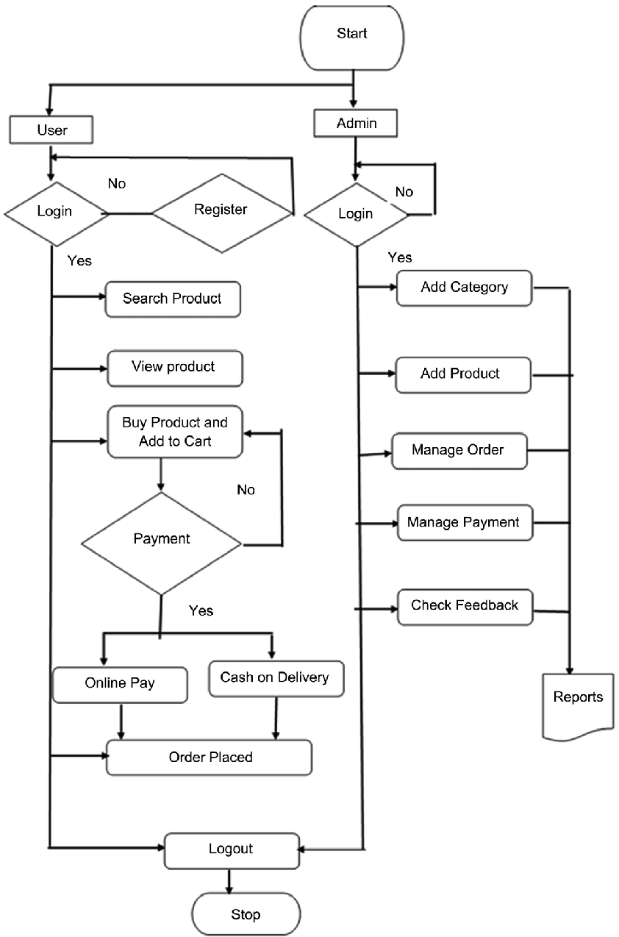
Flowchart :

Slide 9
What is an Ecommerce Tech Stack?
An ecommerce tech stack refers to the combination of tools, frameworks, platforms, and programming languages used to build and run an online store. It comprises both front-end and back-end technologies, along with third-party integrations that enhance functionality, user experience, and performance.
Key Components of an Ecommerce Tech Stack
A comprehensive ecommerce tech stack typically includes the following components:

Slide 10
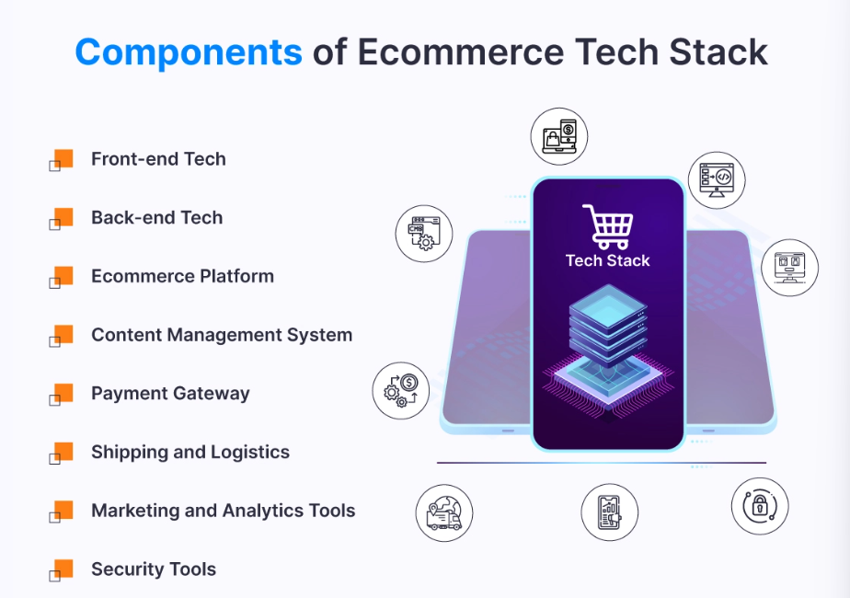

Slide 11
Front-End Technologies
These are the technologies that shape the user interface and experience. They include HTML, CSS, JavaScript, and frameworks like React, Angular, and Vue.js. These technologies determine how your site looks, feels, and interacts with users.
Back-End Technologies
Spring Security for authentication and security
Hibernate/JPA for ORM (interacting with databases).
MySQL/PostgreSQL (relational) or MongoDB (NoSQL) for data storage.
Redis for caching, and Kafka for messaging.
Security:
OAuth2, JWT, and SSL/TLS for secure authentication and data transfer.
Payment Gateways:
Integrate with Stripe, PayPal, or Razorpay for transactions.
Search and Performance:
Elasticsearch for fast product search.
Docker and Kubernetes for containerization and deployment.
Cloud Hosting & Monitoring:
AWS/GCP for cloud services.
Prometheus/Grafana for monitoring system performance.

Slide 12
Conclusion
An online e-commerce platform is essential for connecting businesses with customers in the digital marketplace. By integrating user-friendly interfaces, secure payment systems, and a robust technology stack, these platforms ensure seamless transactions and enhance customer experiences. Key features like product search, user authentication, and order management contribute to streamlined operations. As e-commerce continues to grow, a well-designed platform drives sales and fosters customer loyalty, positioning businesses for long-term success.

Slide 13


